Slide 1
Current Stats Of Account O3 and Happiness Index-DFA
Manoj Bisht - 168869

Slide 2
What is O3(One-on-Ones)
A one-on-one conversation in a company between a supervisor and a supervisee is a regular meeting where they discuss the employee's work, performance, goals, and any challenges. It aims to provide feedback, set goals, offer guidance, address issues, and build a strong working relationship. It helps with performance management, career development, problem-solving, and employee engagement. These conversations promote effective communication, support individual growth, and contribute to a positive work environment.

Slide 3
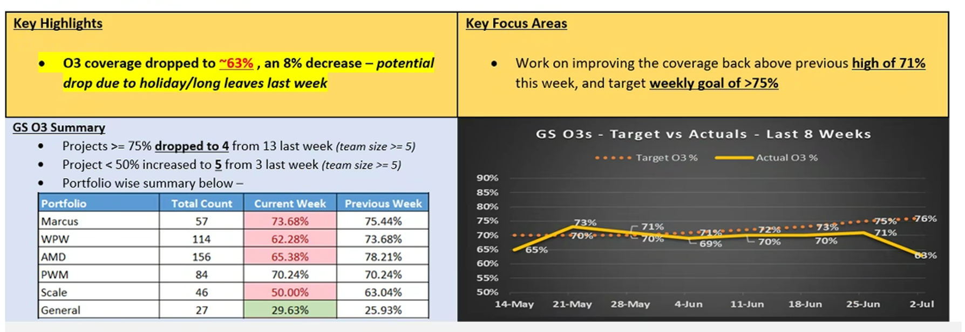
Current Stats of Account O3

Slide 4
What to do to improve O3 Stats
Set clear objectives for each conversation.
Discuss skill development and learning opportunities.
Recognize and appreciate the supervisee's achievements.
Address challenges together and provide support.
Be flexible and adapt to the supervisee's needs.

Slide 5
What is DFA (Delivery Focus Areas)
Delivery Focus Areas (DFAs) Surveys is one of the DOJO tools provided to all Delivery Teams of Publicis Sapient to assess the health of a project on key parameters of Speed, Quality, Value on a Quarterly cadence.
Once every quarter, the DOJO Team pushes the DFA survey to PS Engagements that have enrolled for survey in that quarter. Survey runs for one week to give enough time for team members distributed globally to take the survey.
Once survey concludes all participating team receive survey results for their respective teams post which they discuss survey outcomes together with their teams to assess improvement areas and current strengths.

Slide 6
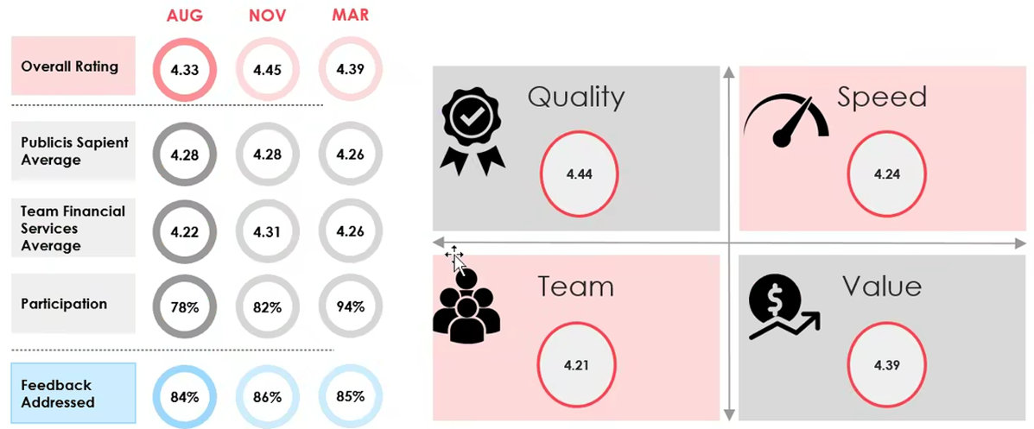
DFA Stats in last 3 Survey

Slide 7
Thank You

